Slide 1

Covid-19|Testing Finder

Slide 2
COVID-19 Testing Finder
We want our health-conscious users to get the latest information on Covid-19, including nearby testing centers, national-statistics, relevant news articles, and adher to expert-recommendations.

Slide 3
Concept
Our site offers our users testing centers, latest news articles, statistics and CDC guidelines in their area. We gather this information in the first landing page, where the user will input their city and state.
Our team's motivation was to provide users with a page that provides the user with relevant information regarding Covid-19 in their area.
As a health-conscious I want to get the latest information on Covid-19, including nearby testing centers, national-statistics, and relevant news articles so that I can be well-informed and ensure I’m adhering to expert-recommendations.

Slide 4
Process
Technologies used
Breakdown of tasks and roles
Challenges
Successes

Slide 5


Slide 6
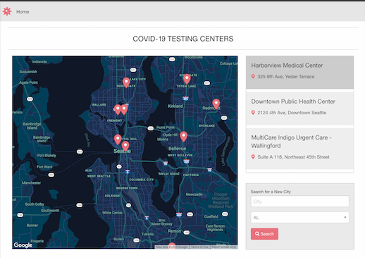

Slide 7
Directions for Future Development
Adding more features for the API to display on the page
some more styling

Slide 8
Links
Deployed link
https://easyacres.github.io/TestingCenterLocator/index.html
Github Repo
https://github.com/easyacres/TestingCenterLocator

